Slide 1
Aflac WorkForces Report
2013-2017

Slide 2
Confidential and Proprietary. For Internal Use Only. Do Not Distribute. These materials contain proprietary information and material that is owned by Aflac and/or its licensors, and is protected by applicable intellectual property and other laws, including but not limited to copyright. By accessing these materials, you agree that you will not use such proprietary information or materials in any way whatsoever except for the sole purpose of training and development within Aflac’s field force. You further agree not to modify, loan, sell, distribute, or create derivative works based on these materials. Any use not specifically permitted herein shall be considered to be a material breach of your Agent's contract with Aflac and is strictly prohibited. Any use not specifically permitted herein is strictly prohibited and may subject you to civil and criminal penalties, including possible monetary damages and termination of your agreement with Aflac.
Z170668 6/18

Slide 3
About the Aflac WorkForces Report
Seventh annual study
Results from 35,000 employees and 13,000 employers across seven years
Statistically valid samples — industries, company sizes, geography and demographics
Third-party research to gain an understanding of benefits trends and challenges
* EE: 2011=3,035, 2012=6,151, 2013=5,299, 2014=5,209, 2015=5,377, 2016=5,000, 2017=5,000, TOTAL=35,071
* ER: 2011=2,117, 2012=1,847, 2013=1,884, 2014=1,856, 2015=1,977, 2016=1,500, 2017=1,800, TOTAL=12,981

Slide 4
Trends | Employer Results
2013-2017

Slide 5
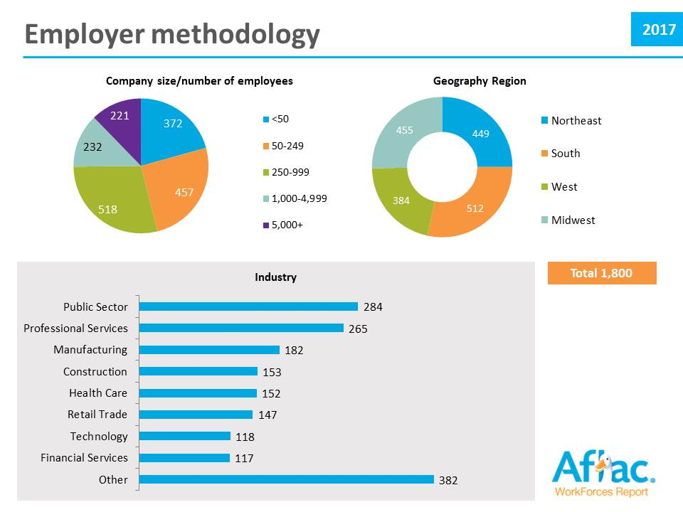

Slide 6
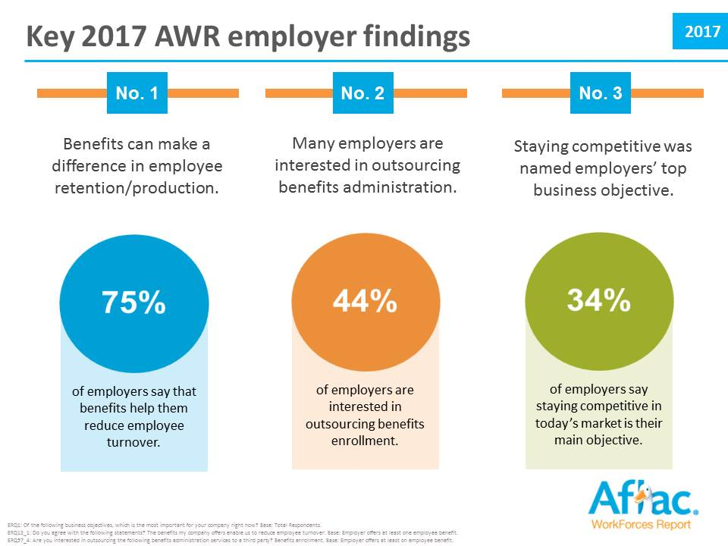

Slide 7
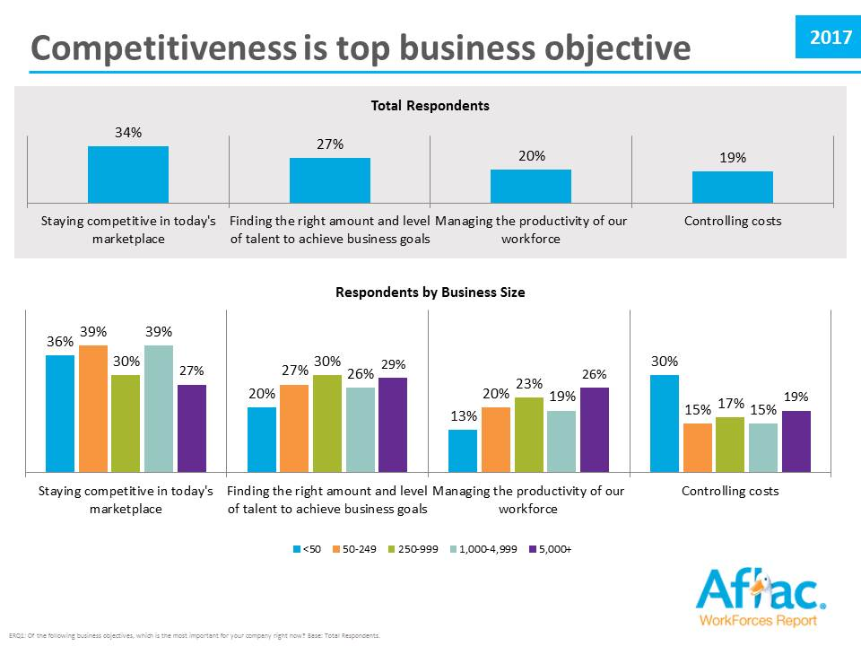

Slide 8
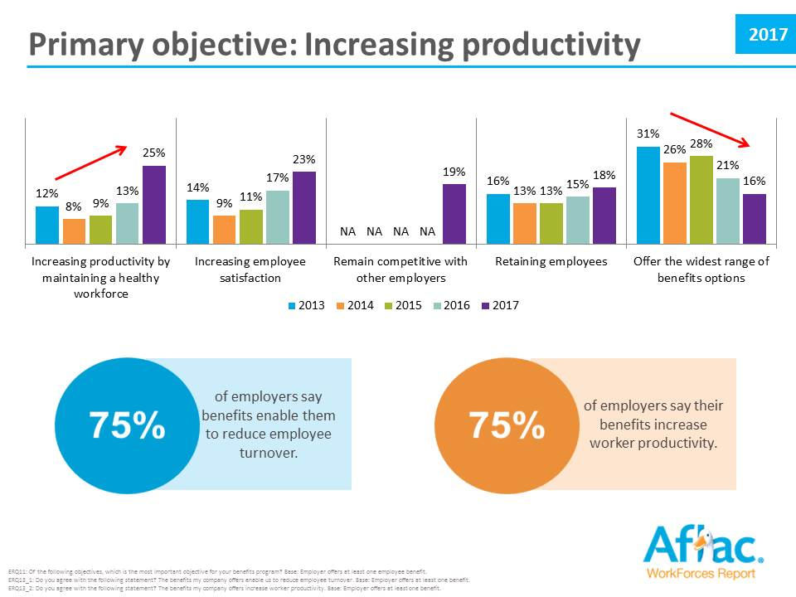

Slide 9
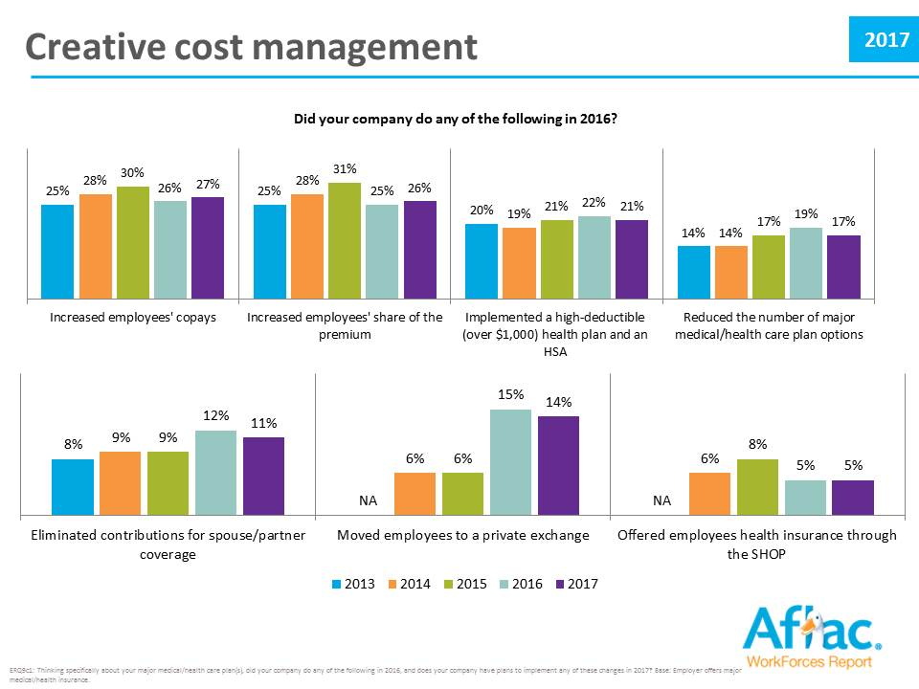

Slide 11
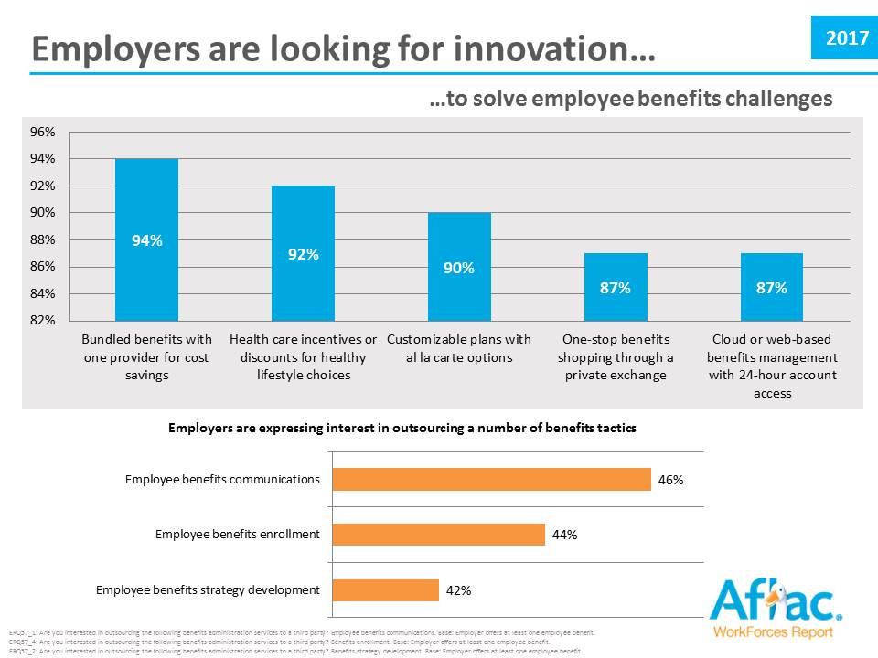

Slide 12
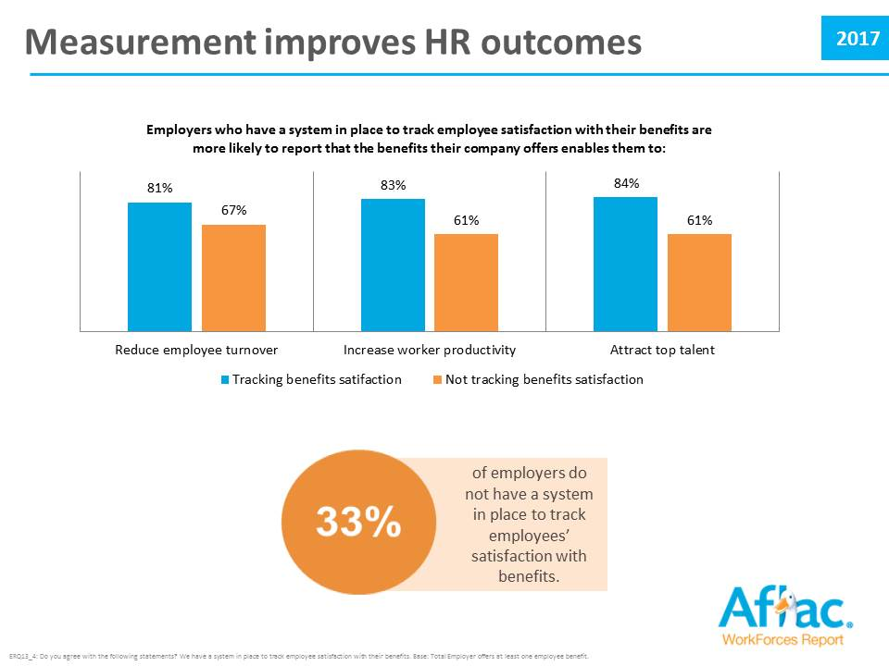

Slide 13
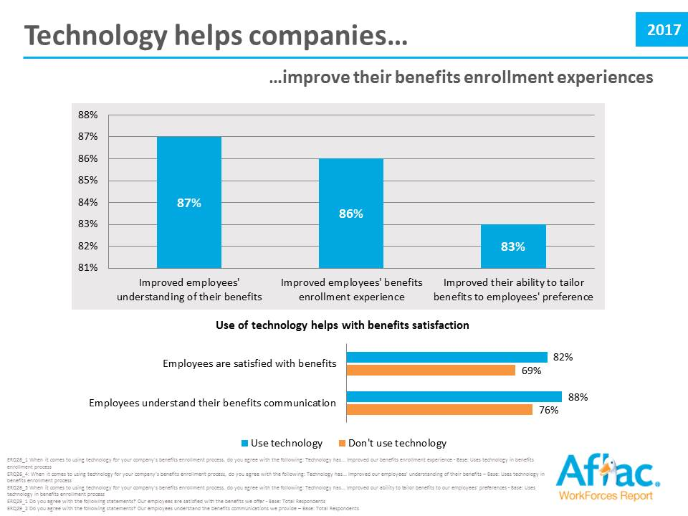

Slide 15
Trends | Employee Results
2013-2017

Slide 16
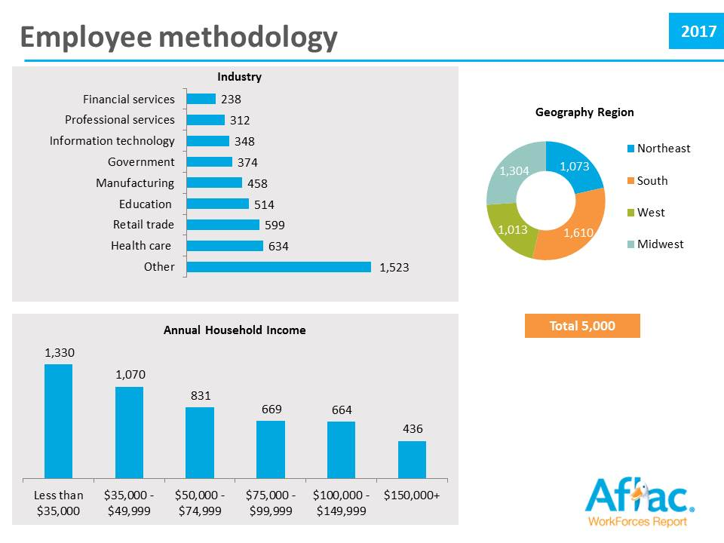

Slide 17
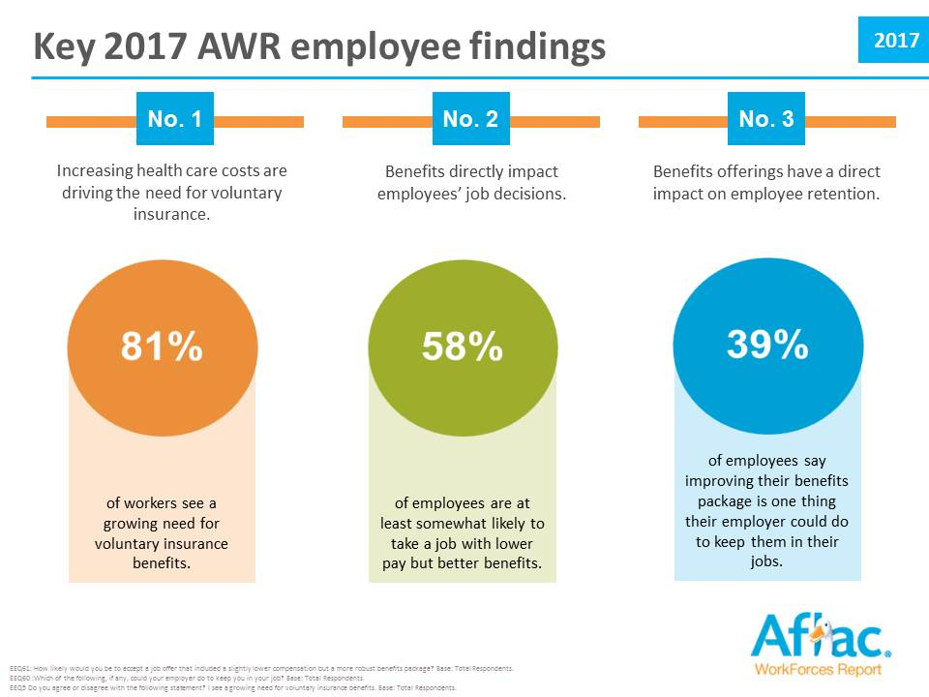

Slide 18
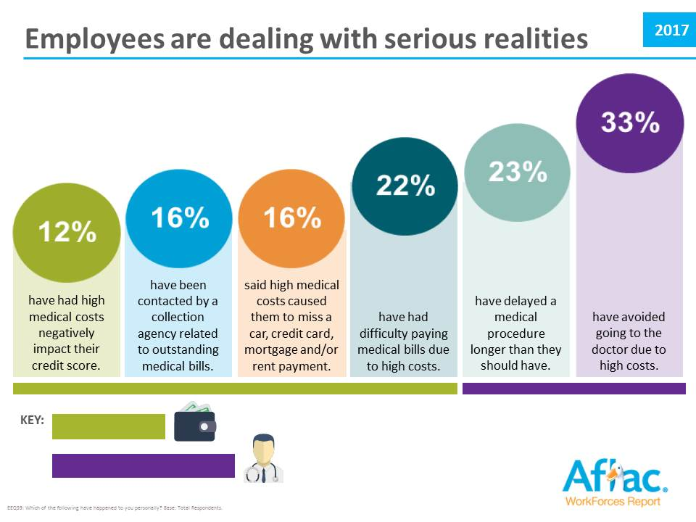

Slide 19
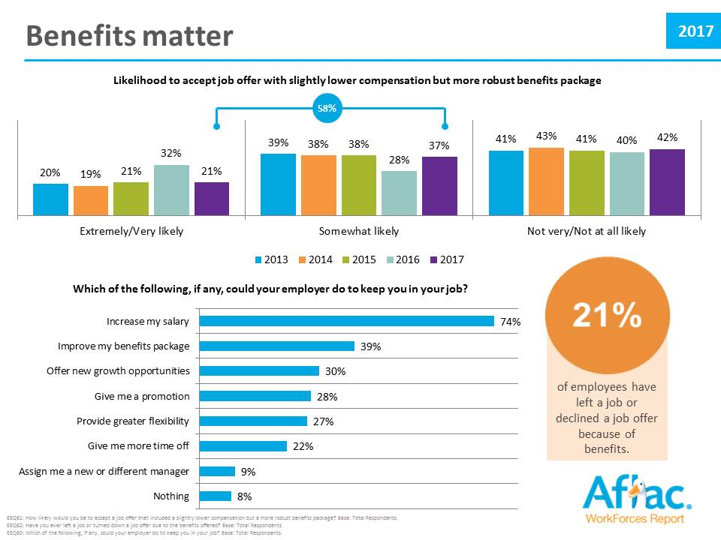

Slide 20
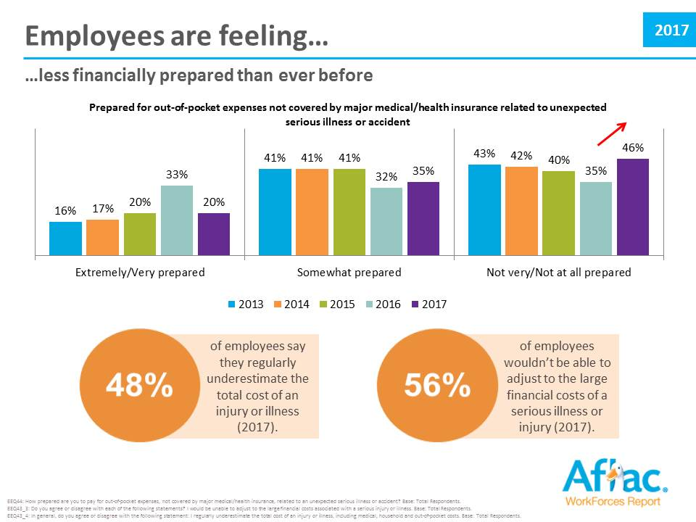

Slide 21
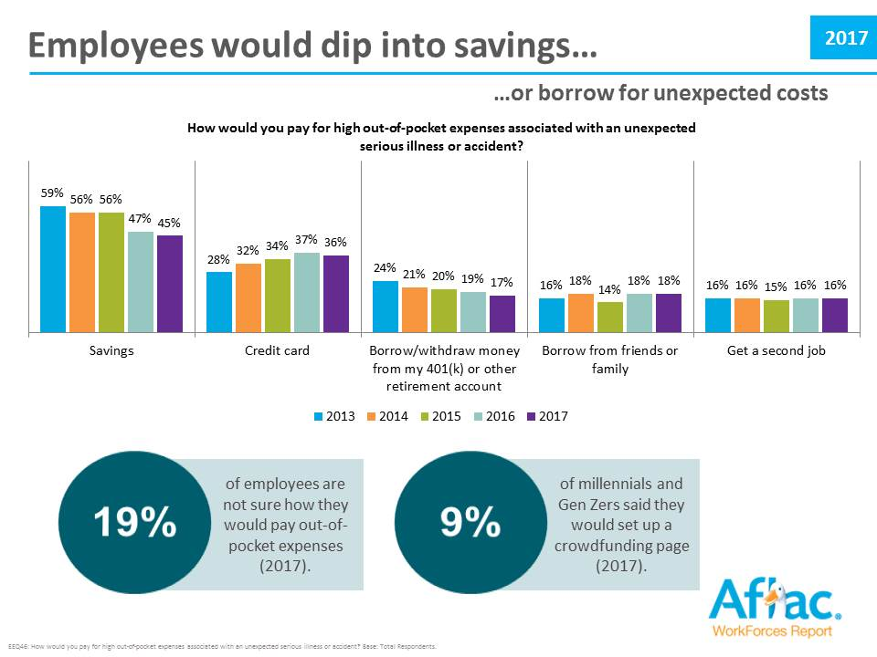

Slide 22
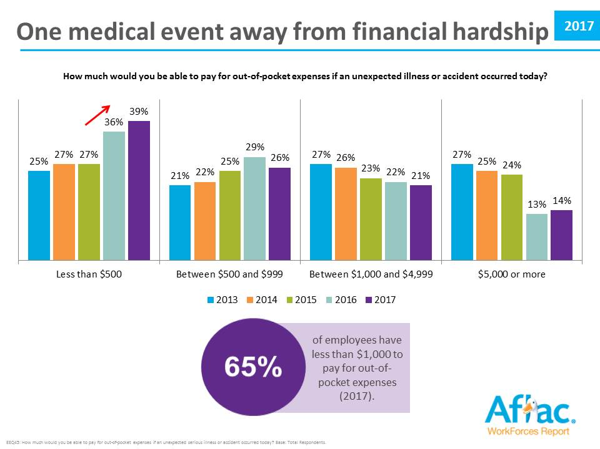

Slide 24
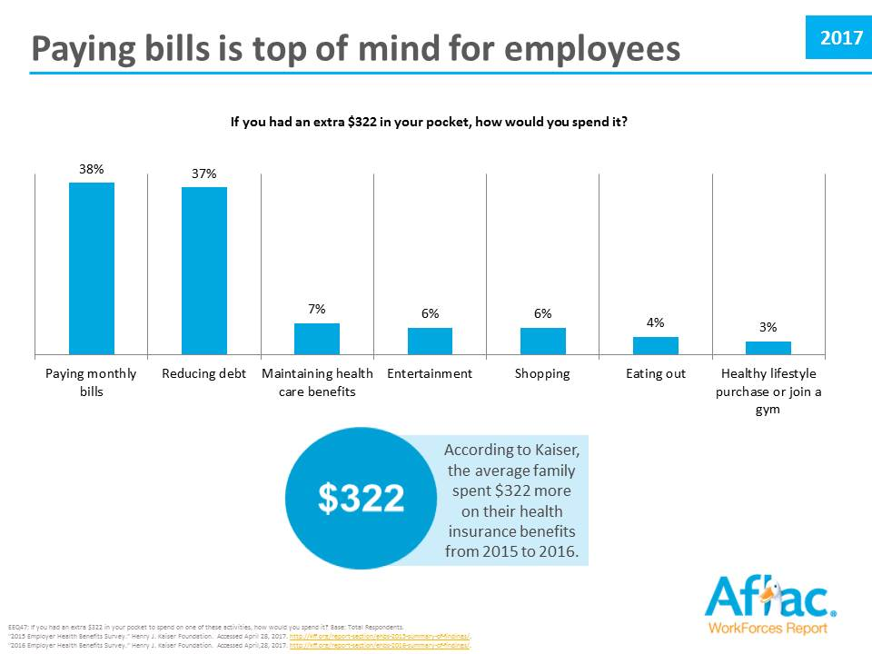

Slide 25
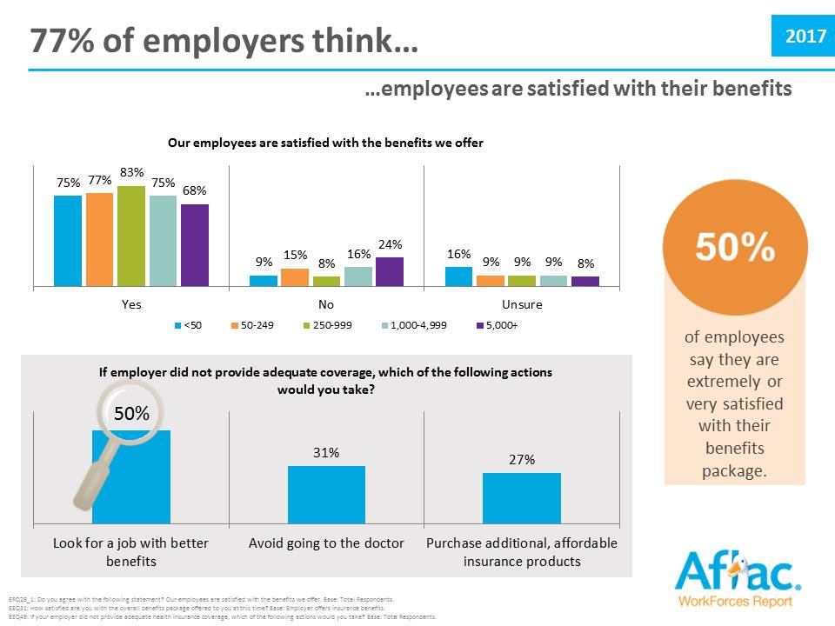

Slide 26
The Growing Importance of Voluntary
2013-2017

Slide 27
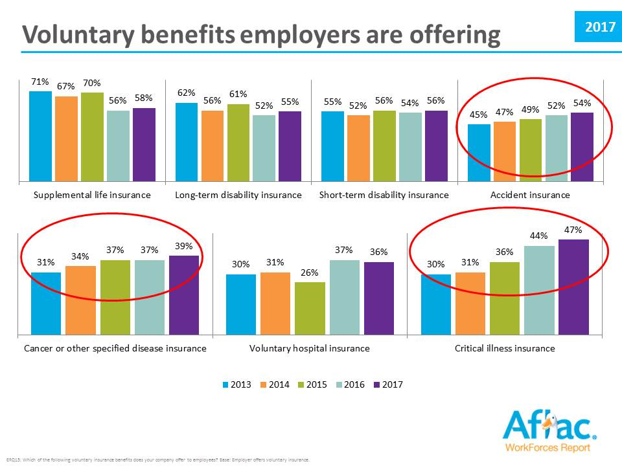

Slide 28
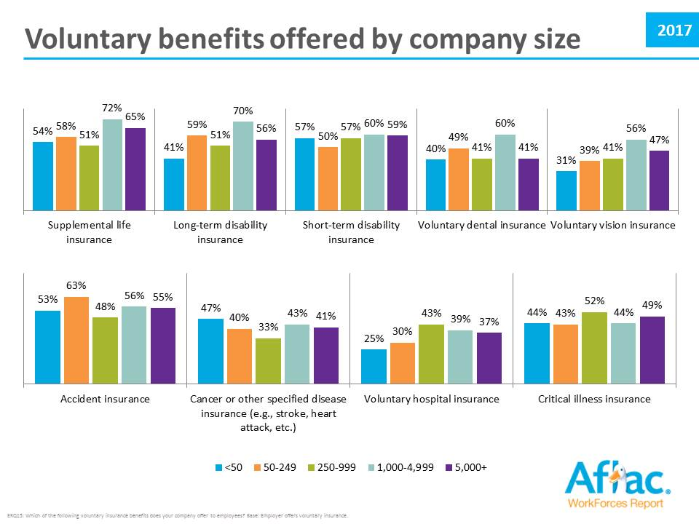

Slide 29
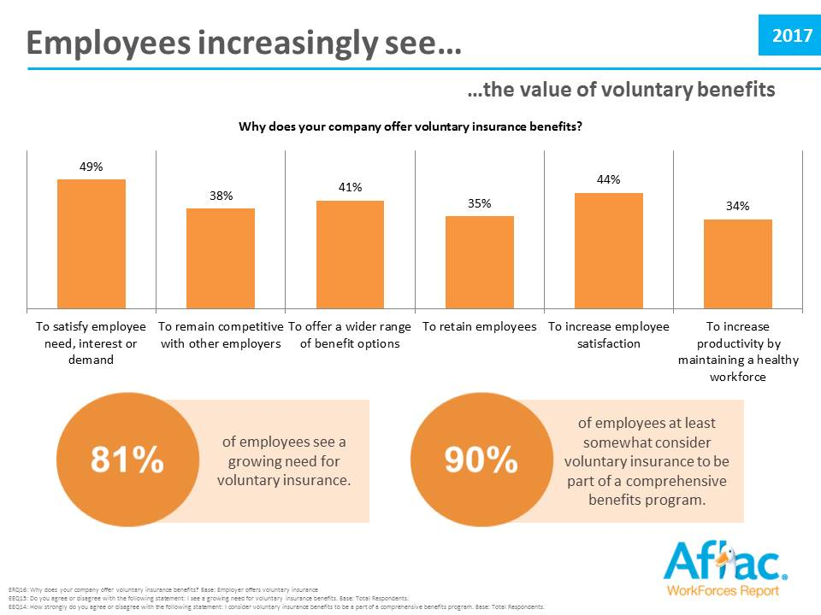

Slide 30
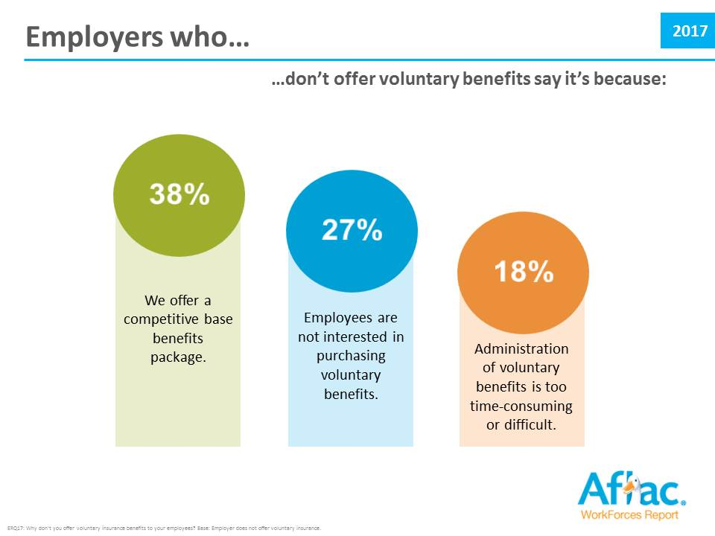

Slide 31
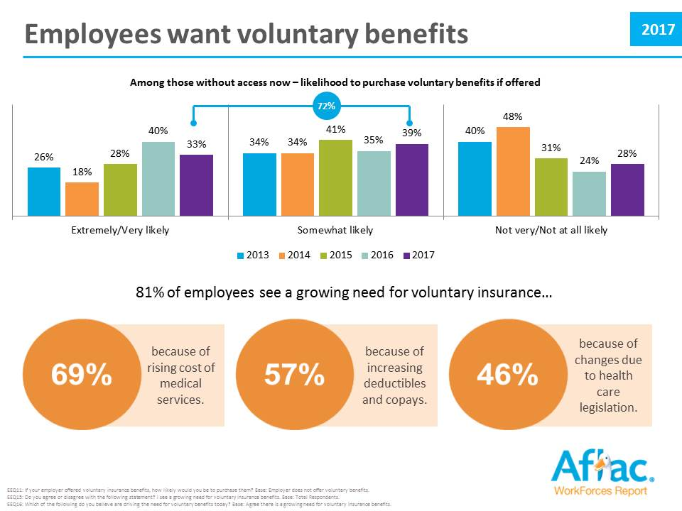

Slide 34
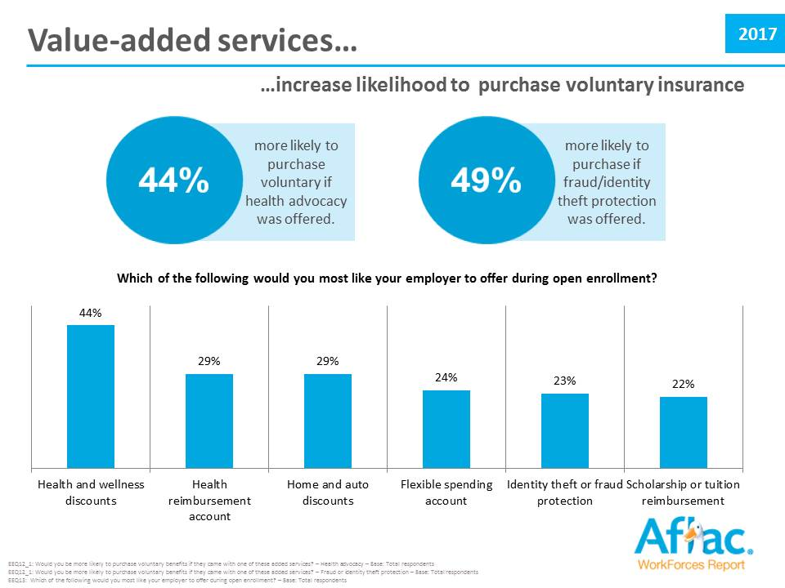

Slide 37
Aflac WorkForces Report
2013-2017
Learn more at: AflacWorkForcesReport.com
Ask about cobranding AWR collateral.
Articles
Infographics
Fact Sheets
Executive Summary

