Slide 1
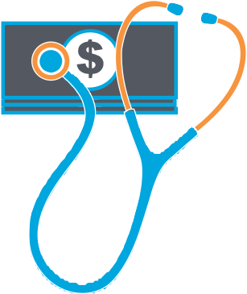
Many workers are facing financial crisis
42% say they are not at all or not very prepared to pay for
out-of-pocket expenses associated with a serious illness or injury.
69% of workers at least somewhat agree that they regularly underestimate the total cost of an injury or illness, including medical, household and OOP expenses.
13% are currently dealing with high medical bills.
Nearly one-quarter (24%) of the workforce has been contacted by a collection agency due to medical costs and/or had their credit score negatively impacted.
10% of workers have missed bill payments due to high medical costs.
Source:
2014 Aflac WorkForces Report
Z140813
8/14
This article is for informational purposes only and is not intended to be a solicitation.
Aflac herein means American Family Life Assurance Company of Columbus and American Family Life Assurance Company of New York. WWHQ | 1932 Wynnton Road | Columbus, GA 31999.

Slide 2
Workers are not financially prepared
42% say they are not at all or not very prepared to pay for
out-of-pocket expenses associated with a serious illness or injury.
49% of employees have $1,000 or less to pay for out-of-pocket expenses associated with an unexpected serious illness
or accident.
27% of employees have less than $500 available to pay for
out-of-pocket expenses associated with an unexpected serious illness or accident.
39% of workers would have to borrow from their 401(K) and/or from friends and family to pay for out-of-pocket expenses associated with an unexpected serious illness or accident.
Source:
2014 Aflac WorkForces Report
Z140814
8/14

Slide 3
Workers are not financially prepared
42% say they are not at all or not very prepared to pay for
out-of-pocket expenses associated with a serious illness or injury.
49% of employees have $1,000 or less to pay for out-of-pocket expenses associated with an unexpected serious illness
or accident.
27% of employees have less than $500 available to pay for
out-of-pocket expenses associated with an unexpected serious illness or accident.
39% of workers would have to borrow from their 401(K) and/or from friends and family to pay for out-of-pocket expenses associated with an unexpected serious illness or accident.
Source:
2014 Aflac WorkForces Report
Z140815
8/14

Slide 4
Workers are not financially prepared
42% say they are not at all or not very prepared to pay for
out-of-pocket expenses associated with a serious illness or injury.
49% of employees have $1,000 or less to pay for out-of-pocket expenses associated with an unexpected serious illness
or accident.
27% of employees have less than $500 available to pay for
out-of-pocket expenses associated with an unexpected serious illness or accident.
39% of workers would have to borrow from their 401(K) and/or from friends and family to pay for out-of-pocket expenses associated with an unexpected serious illness or accident.
Source:
2014 Aflac WorkForces Report
Z140816
8/14

